Slide 1
Simulation and Modeling
CSE4131_CSE4132

Slide 2
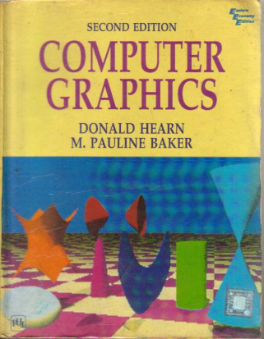
Reference Book
Computer Graphics (2nd Edition)
D. HEARN
M. P. BAKER

Slide 3
Some Commonly Used Splines
Some commonly used Splines and their matrix and blending-function specifications
Cubic Spline Interpolation Method
Natural Cubic Splines
Hermit Spline
Cardinal Splines
Kochanek-Bartels Splines

Slide 4
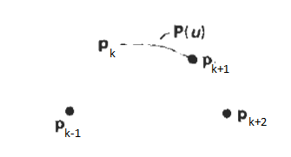
Cardinal Splines
A cardinal spline section is completely specified with four consecutive control points.
The middle two control points are the section endpoints,
and the other two points are used in the calculation of the endpoint slopes
If we take P(u) as the representation for the parametric cubic point function for the curve section between control points p_{k} and p_{k+1}, then the four control points from p_{k-1}, to p_{k+1}, are used to set the boundary conditions for the cardinal spline

Slide 5
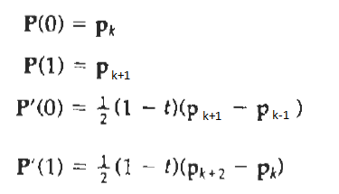
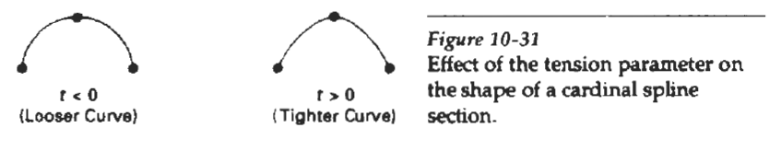
Cardinal Splines
Four control points from p_{k-1}, to p_{k+1}, are used to set the boundary conditions for the cardinal spline section as:
Eq. 10.35
Thus, the slopes at control points p_{k} and p_{k+1} are taken to be proportional, respectively, to the chords p_{k-1}p_{k+1} and p_{k}p_{k+2}
Parameter t is called the
tension parameter (since it controls how loosely or tightly the cardinal spline fits the input control points.)
Figure 10-31 illustrates the shape of a cardinal curve for very small and very large values of tension t. When t = 0, this class of curves is referred to as Catmull-Rom Splines, or Overhauser Splines.

Slide 6
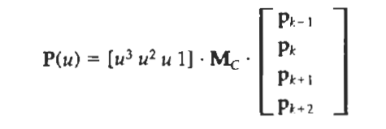
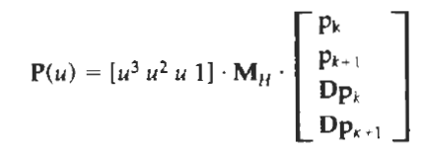
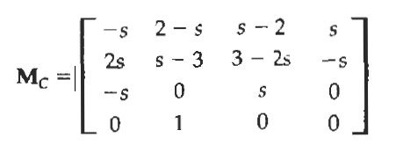

Cardinal Splines
Using methods similar to those for Hermite Splines, we can convert the boundary conditions Eq.10-35 into the matrix form:
Eq. 10.35
Eq. 10.36
where
Cardinal Matrix

Slide 7
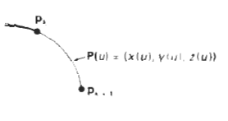
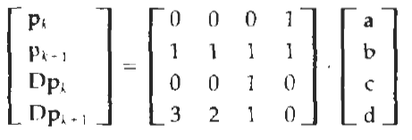
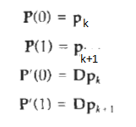
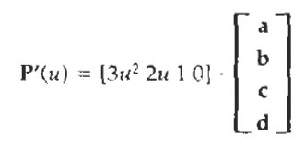
Hermite Interpolation
Substituting endpoint values 0 and 1 for parameter u into the previous two equations, we can express the Hermite boundary conditions 10-27 in the matrix form:
Eq. 10.27
Eq. 10.30
Eq. 10.28
P(u)=au³+bu²+cu+d
Put u=0

Slide 8
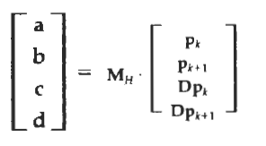
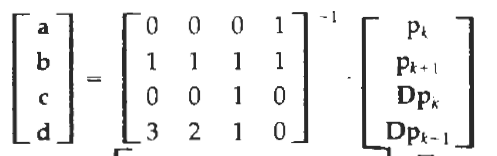
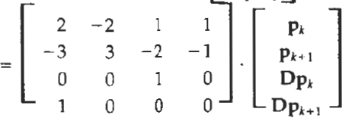
Hermite Interpolation
For matrix calculation: http://www.bluebit.gr/matrix-calculator/
where M_{H} the Hermite matrix, is the inverse of the boundary constraint matrix.

Slide 9
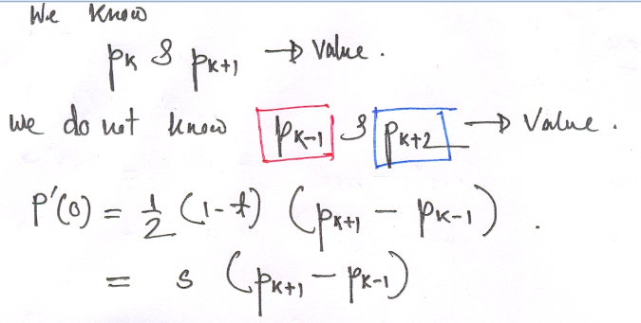
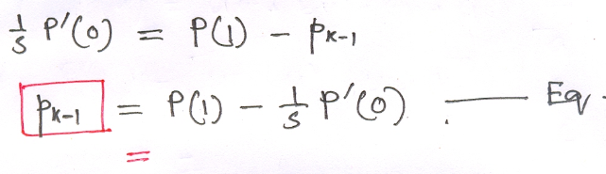
Explanation
Eq. 10.35

Slide 10
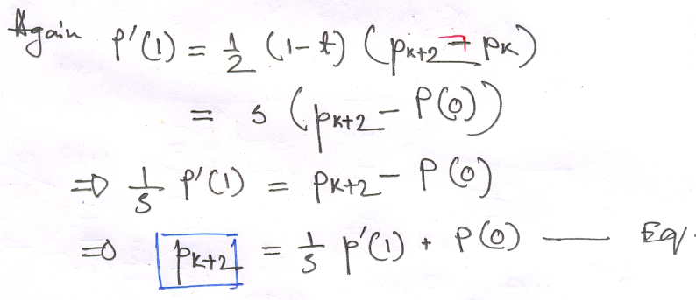
Explanation

Slide 11
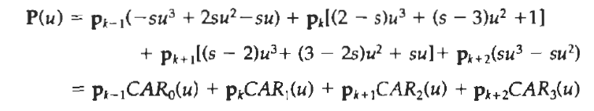
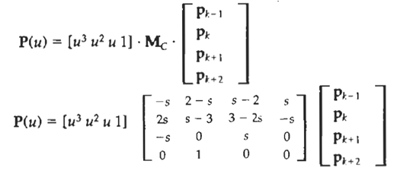
Cardinal Splines
Expanding matrix equation 10-36 into polynomial form, we have
where the polynomials CAR_{k}(u) for k = 0, 1, 2, 3 are the cardinal blending functions.
Figure 10-32 gives a plot of the basis functions for cardinal Splines with t = 0.

Slide 12
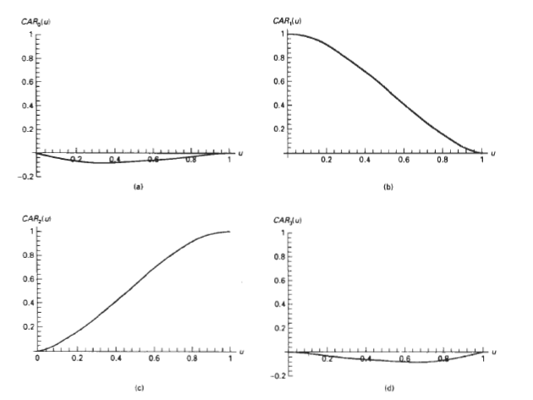
Figure 10-32 gives a plot of the basis functions for cardinal Splines with t = 0.

